Slide 1
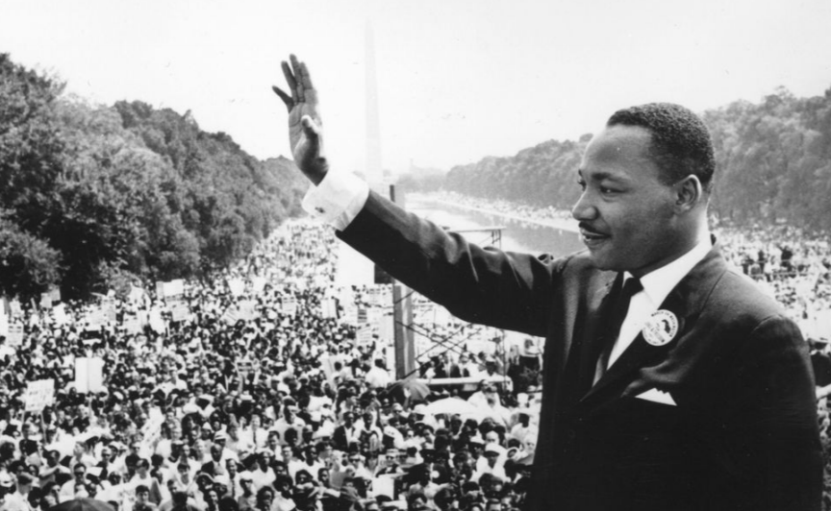
Word
Phrase
Sentence
I Have A Dream
Speech By: Dr. Martin Luther King Jr.
Notes:
Link to Text: https://www.npr.org/2010/01/18/122701268/i-have-a-dream-speech-in-its-entirety

Slide 2
Notes:
Link to Text: https://www.npr.org/2010/01/18/122701268/i-have-a-dream-speech-in-its-entirety

Slide 3
Notes:
Link to Text: https://www.npr.org/2010/01/18/122701268/i-have-a-dream-speech-in-its-entirety

Slide 4
Notes:
Link to Text: https://www.npr.org/2010/01/18/122701268/i-have-a-dream-speech-in-its-entirety

Slide 5
Notes:
Link to Text: https://www.npr.org/2010/01/18/122701268/i-have-a-dream-speech-in-its-entirety

Slide 6
Notes:
Link to Text: https://www.npr.org/2010/01/18/122701268/i-have-a-dream-speech-in-its-entirety

Slide 7
Notes:
Link to Text: https://www.npr.org/2010/01/18/122701268/i-have-a-dream-speech-in-its-entirety

Slide 8
Notes:
Link to Text: https://www.npr.org/2010/01/18/122701268/i-have-a-dream-speech-in-its-entirety

Slide 9
Notes:
Link to Text: https://www.npr.org/2010/01/18/122701268/i-have-a-dream-speech-in-its-entirety

Slide 10
Notes:
Link to Text: https://www.npr.org/2010/01/18/122701268/i-have-a-dream-speech-in-its-entirety

Slide 11
Notes:
Link to Text: https://www.npr.org/2010/01/18/122701268/i-have-a-dream-speech-in-its-entirety

Slide 12
Notes:
Link to Text: https://www.npr.org/2010/01/18/122701268/i-have-a-dream-speech-in-its-entirety

Slide 13
Notes:
Link to Text: https://www.npr.org/2010/01/18/122701268/i-have-a-dream-speech-in-its-entirety

Slide 14
Notes:
Link to Text: https://www.npr.org/2010/01/18/122701268/i-have-a-dream-speech-in-its-entirety

Slide 15
Notes:
Link to Text: https://www.npr.org/2010/01/18/122701268/i-have-a-dream-speech-in-its-entirety

Slide 16
Notes:
Link to Text: https://www.npr.org/2010/01/18/122701268/i-have-a-dream-speech-in-its-entirety

Slide 17
Notes:
Link to Text: https://www.npr.org/2010/01/18/122701268/i-have-a-dream-speech-in-its-entirety

Slide 18
Notes:
Link to Text: https://www.npr.org/2010/01/18/122701268/i-have-a-dream-speech-in-its-entirety

Slide 19
Notes:
Link to Text: https://www.npr.org/2010/01/18/122701268/i-have-a-dream-speech-in-its-entirety

Slide 20
Notes:
Link to Text: https://www.npr.org/2010/01/18/122701268/i-have-a-dream-speech-in-its-entirety

Slide 21
Notes:
Link to Text: https://www.npr.org/2010/01/18/122701268/i-have-a-dream-speech-in-its-entirety

Slide 22
Notes:
Link to Text: https://www.npr.org/2010/01/18/122701268/i-have-a-dream-speech-in-its-entirety

Slide 23
Notes:
Link to Text: https://www.npr.org/2010/01/18/122701268/i-have-a-dream-speech-in-its-entirety

Slide 24
Notes:
Link to Text: https://www.npr.org/2010/01/18/122701268/i-have-a-dream-speech-in-its-entirety

Slide 25
Notes:
Link to Text: https://www.npr.org/2010/01/18/122701268/i-have-a-dream-speech-in-its-entirety

